Slide 1

RESEARCH CONTENT MANAGEMENT
Team Members:
Nithin Reddy Kumbham
Vamsidhar Reddy Police
Saivivek Reddy Kusukuntla
Jawahar Reddy Nomula
Gopi Krishna Kandimalla
Abhinav Bellamkonda

Slide 2

Roles and Responsibilities
Front-end Development
Vamsidhar Reddy Police
Saivivek Reddy Kusukuntla
Back-end Development
Nithin Reddy Kumbham
Abhinav Bellamkonda
Database Management
Jawahar Reddy Nomula
Gopi Krishna Kandimalla

Slide 3

Register
The first step in our project is the user to create an account so that user can upload documents and leave comments for future reference.
The registration page asks for the user's name, email address, and password, which are saved in firebase authentication when the user clicks the register button.
After creating an account, the user can successfully log in to the application using the credentials provided at registration.
It should be noted that during registration, all fields are required, and skipping any field results in a message stating that the field cannot be left blank.

Slide 4
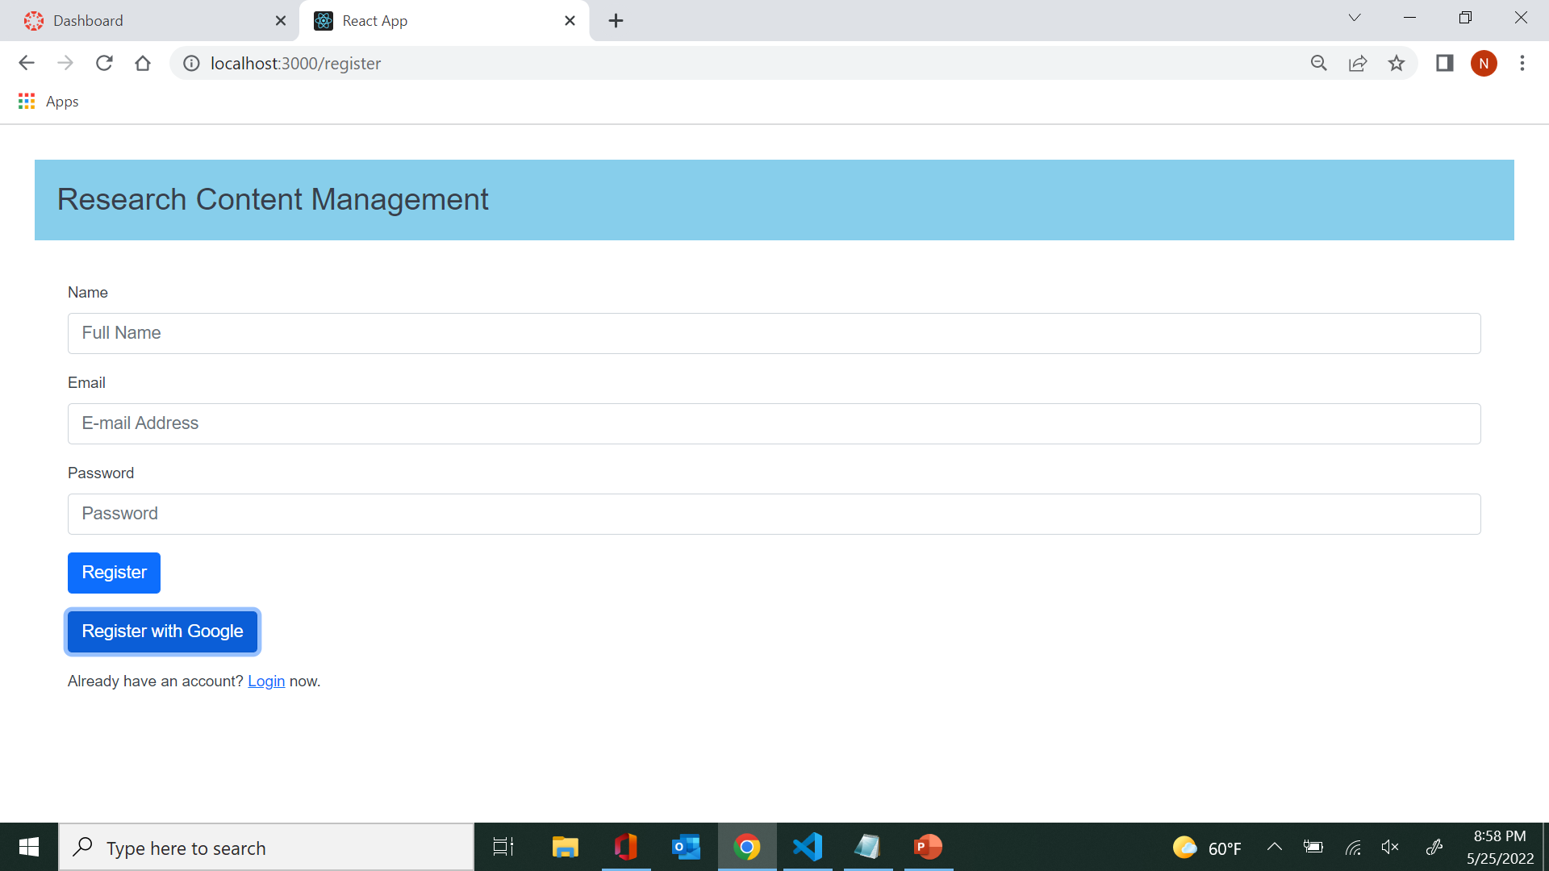

Slide 5

Login
Once the user has completed the registration successfully, the dashboard is displayed, and he can complete his operations.
Whenever the registered user comes back, he can access to the login page and enter the credentials, which he used during the registration process.
The authentication details are stored in the firebase, so if the details matches, it will render the next page otherwise it will throw an error.
In the Login page, we added a button called "Login With Google", where the user can directly login using his google account

Slide 6
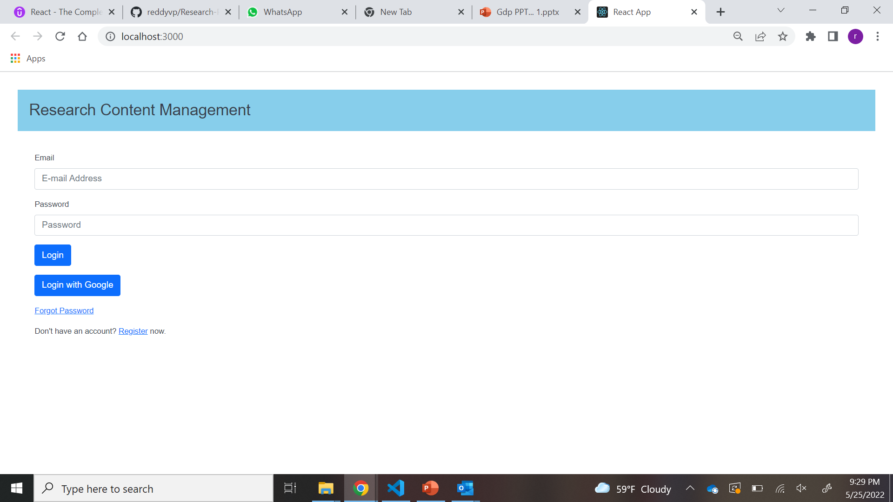

Slide 7

Dashboard
When the user get access to the application after successful login, User will be redirected to dashboard where user can see upload and search tabs. So, that user can navigate between the two tabs easily.
1
In dashboard page user can view his username, email and logout button in Home bar.
2
Upload has options to upload a paper and search has options to view a paper and search a respective paper from a collection of papers.
3

Slide 8
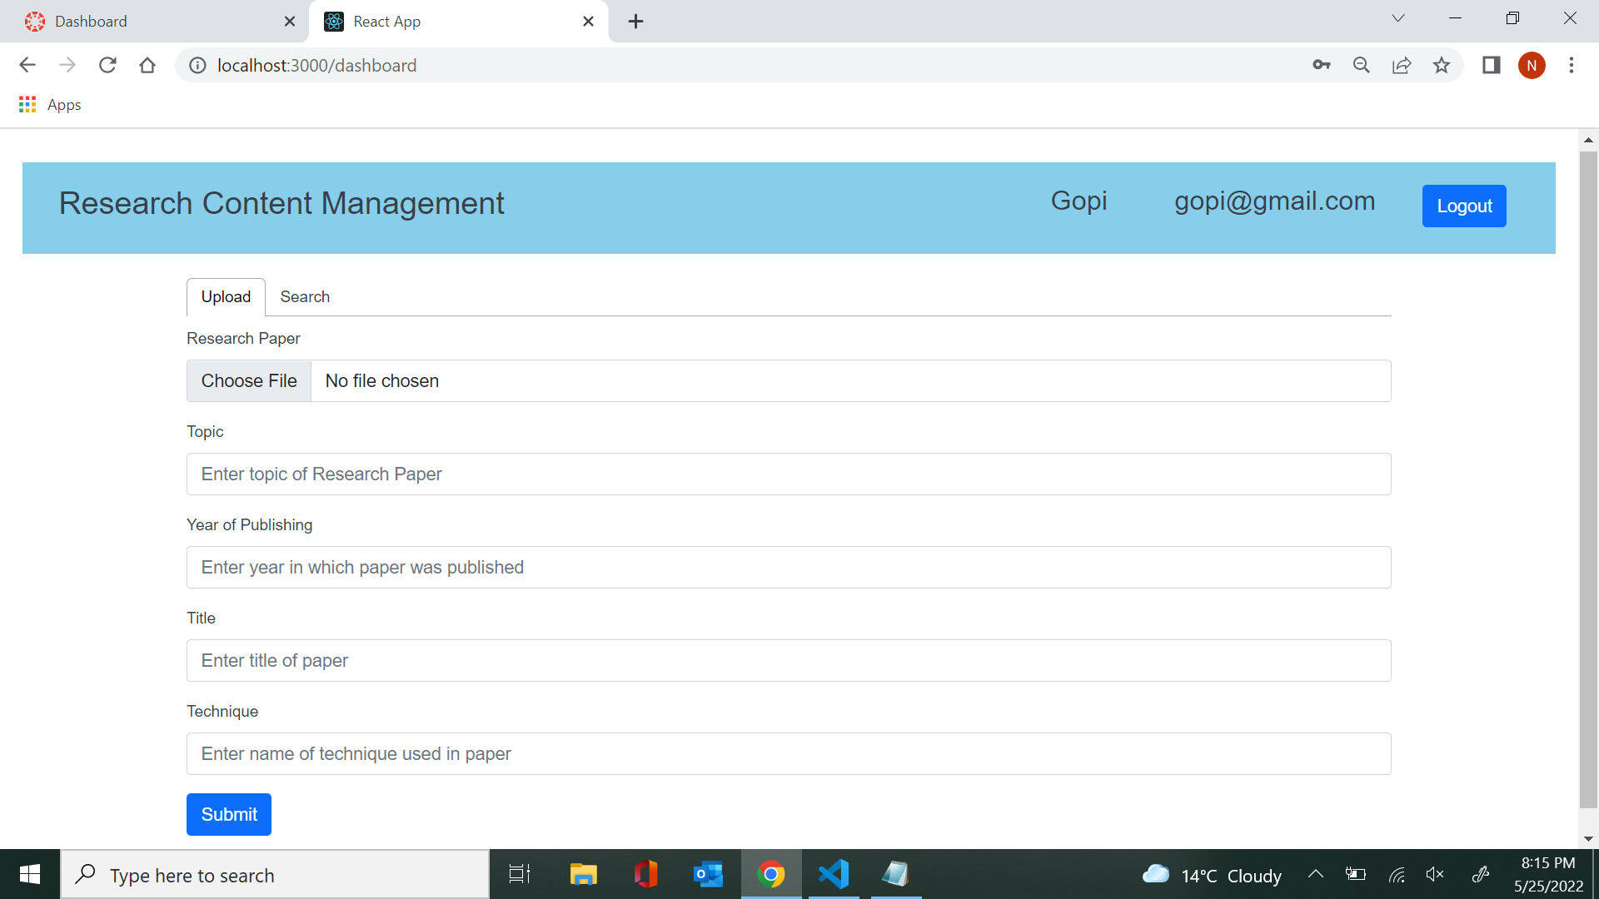

Slide 9
Upload Page
As there is the Upload function for the user to upload the Research paper.
User can select the research paper that user needs to upload which should be in pdf* format.
User must mention the year of publishing, title of the paper, Technique used in the paper and topic of the research paper.
When user clicks on submit button after entering all the above fields the data will be uploaded to firestore database which stores data in database. Once it was uploaded user gets a popup that file has been uploaded successfully.

Slide 10
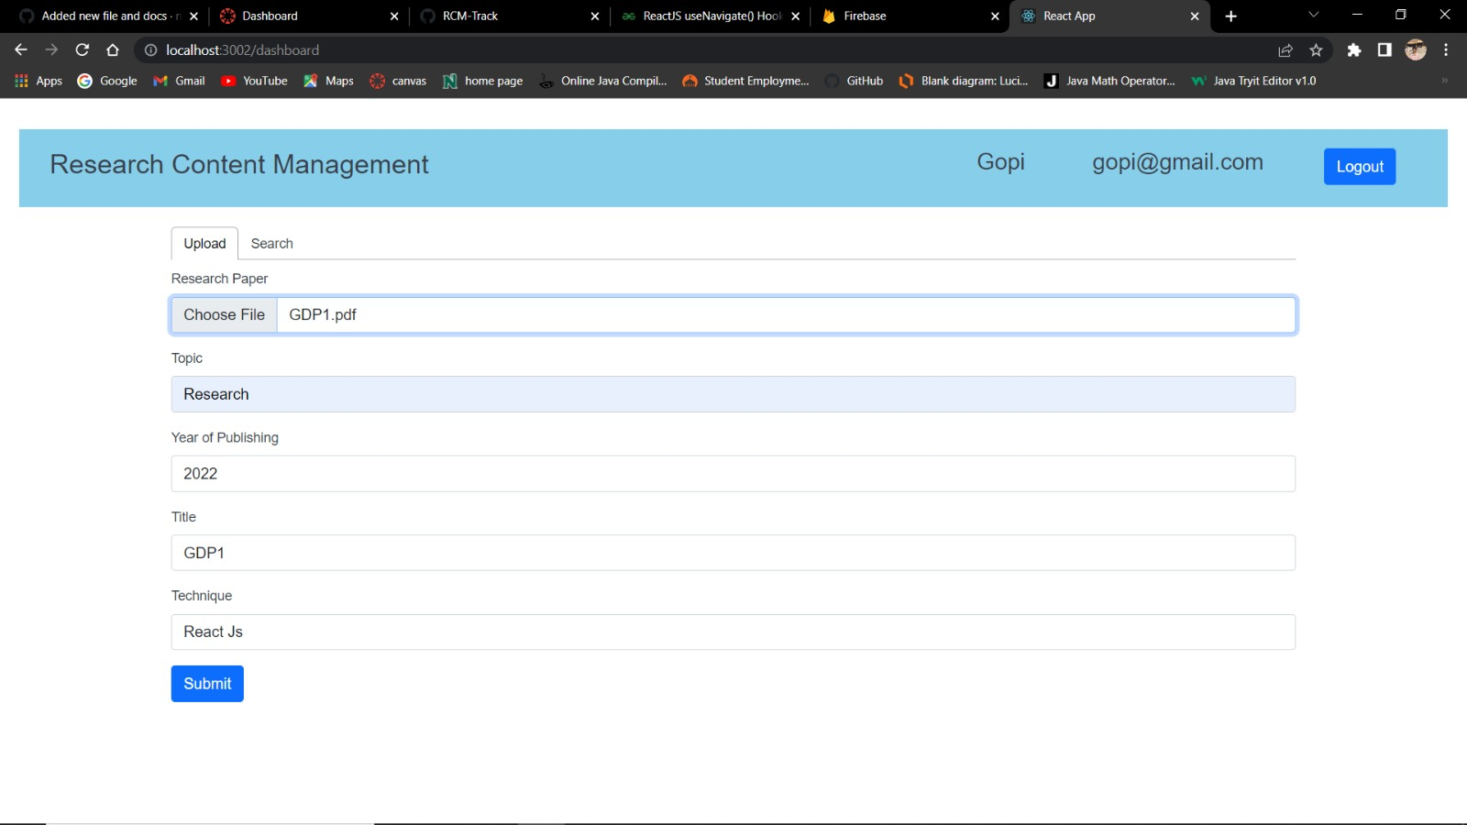

Slide 11

Search Page
Once search page is opened user can see the list of all the uploaded papers.
There is also a sorting function for searching the Research papers.
Sorting can be done by title, year, subtopic and technique.
User can see uploaded papers according to the sorting functions where he can view his research paper on the same page.

Slide 12
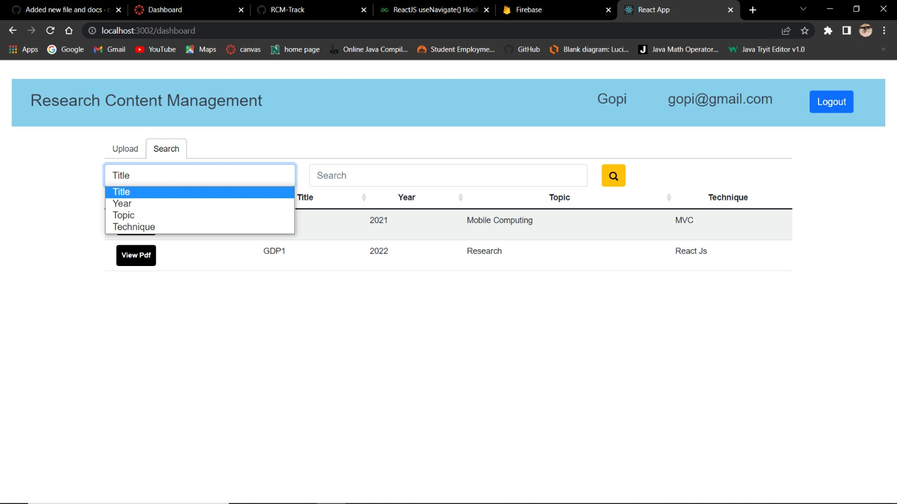

Slide 13
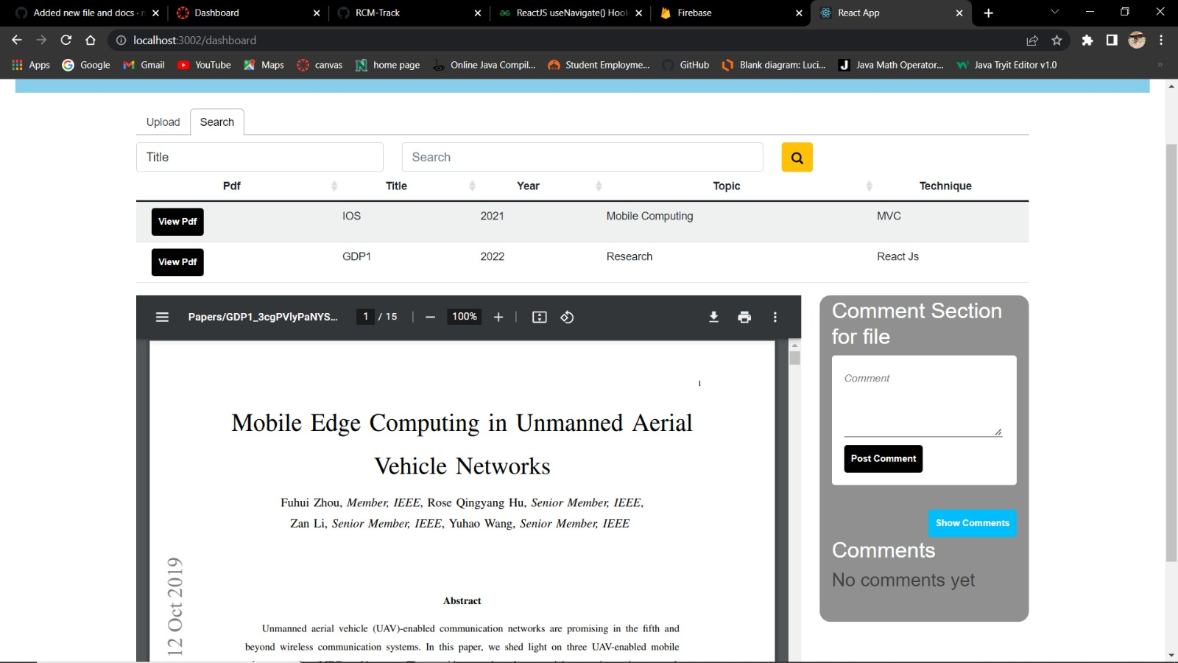

Slide 14

platform developed by Google

Slide 15
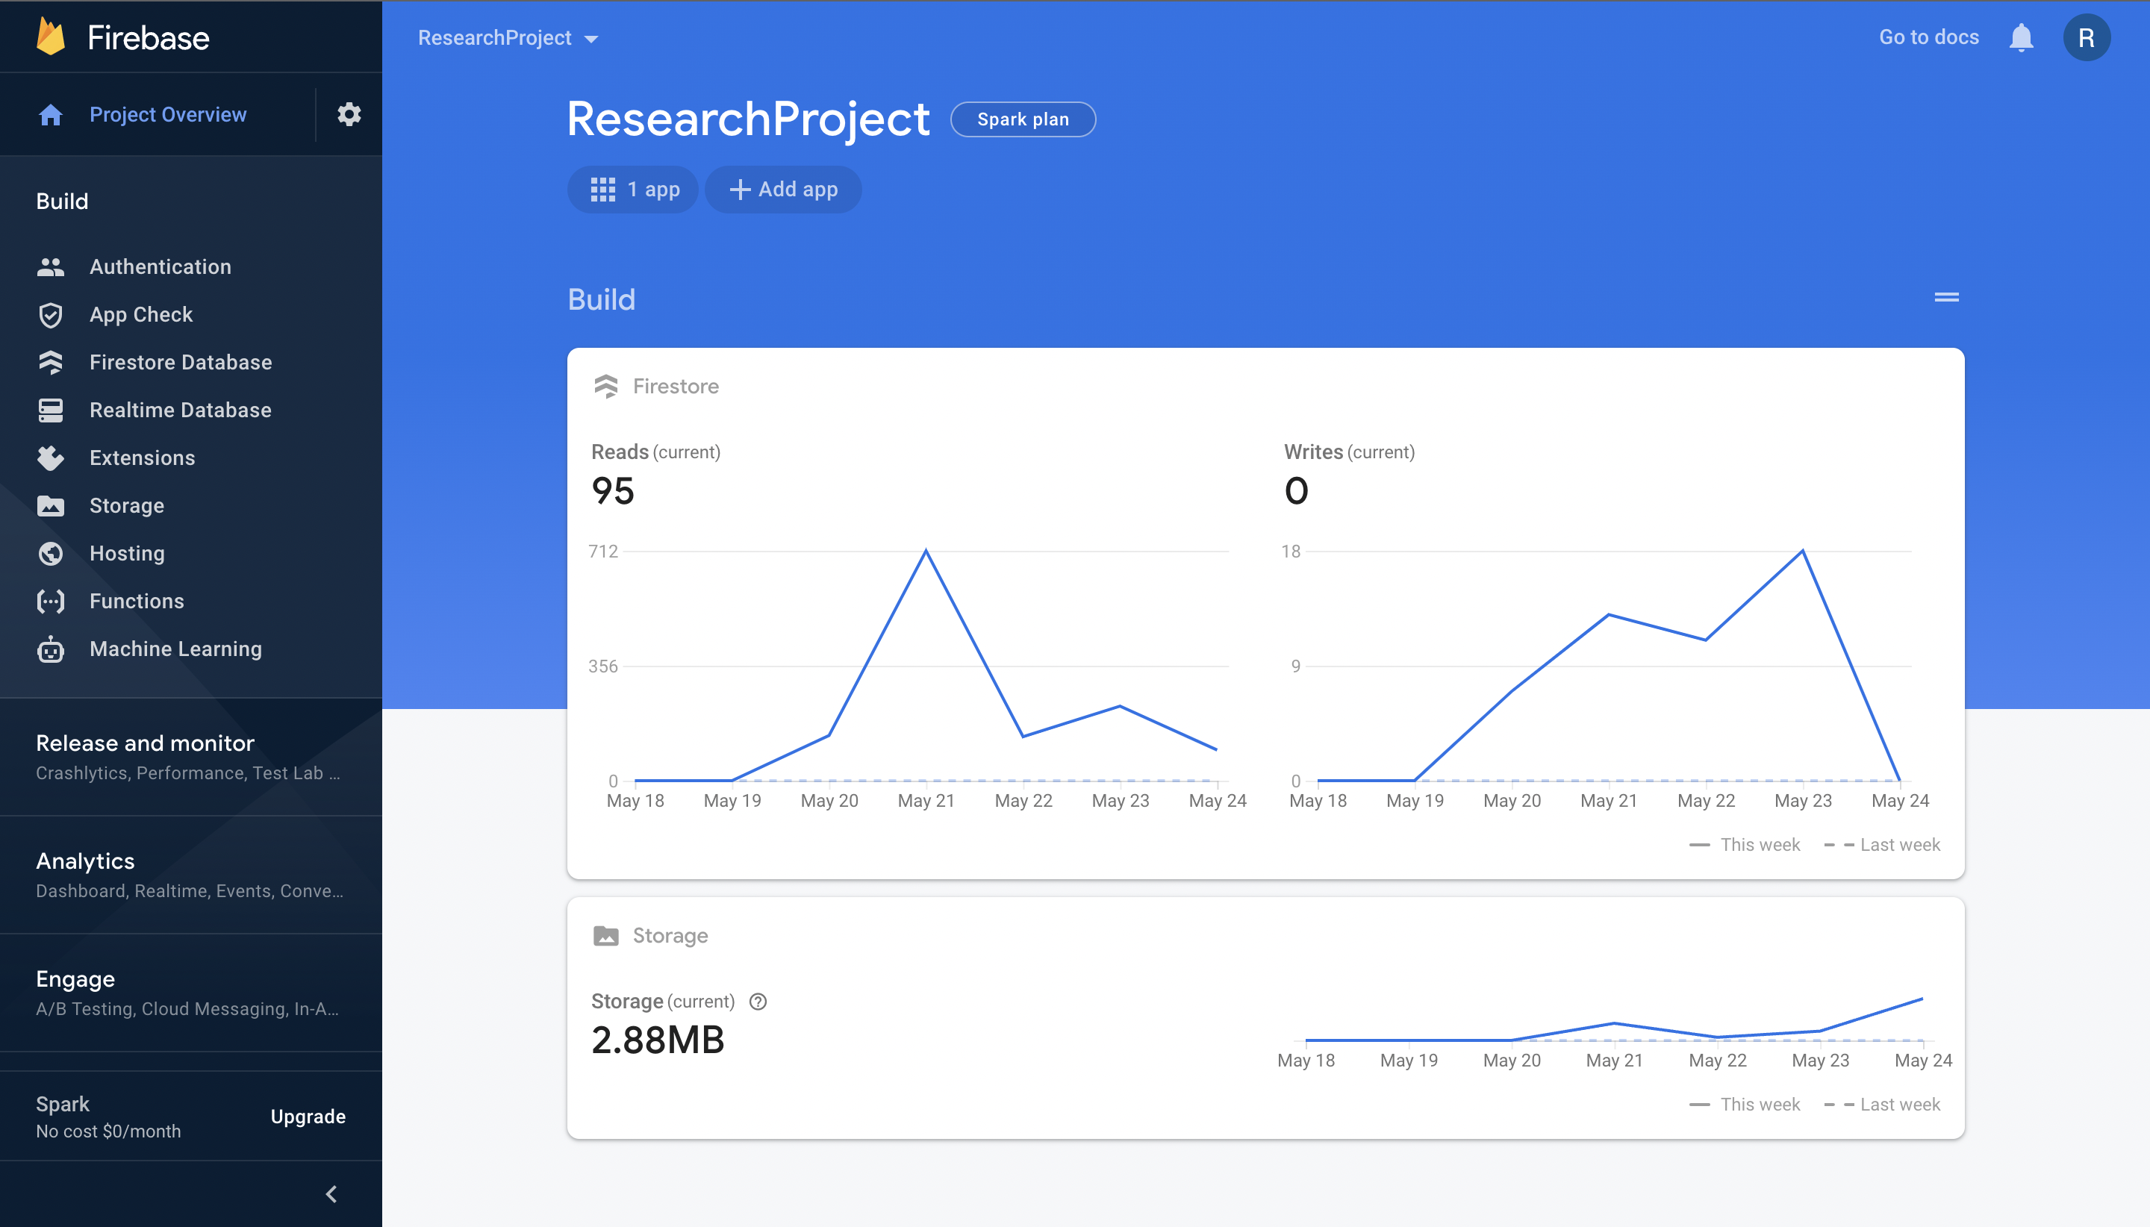

Slide 16
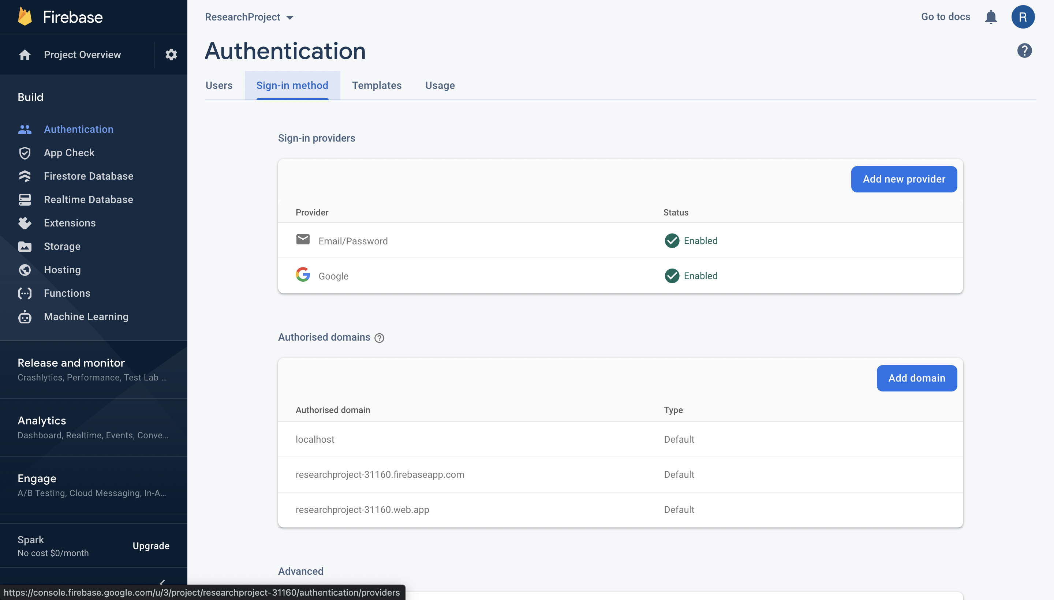
Introducing Firebase Authentication
Here you see the sign-in providers . In our case we used google provider as one of our sign-in option

Slide 17


Slide 18
Introducing Cloud Firestore
Here in Firestore we have rules to set and usage to monitor to the users.
For every file that you upload in your web application that reflects in firestore with a unique user id.
The user id that generated will be able to use for a user to view their data in their respective account when user sign in.
We can aslo monitor the usage of web application.

Slide 20
Introducing Storage
Cloud Storage is designed to help you quickly and easily store and serve user-generated content, such as photos and videos.
No server-side code is needed. It uses Google Cloud Storage buckets to store the files, allowing accessibility from both Google Cloud and Firebase.
A single Firebase project can have multiple storage buckets. The module will use the default bucket if no bucket argument is passed to the storage instance.

Slide 21
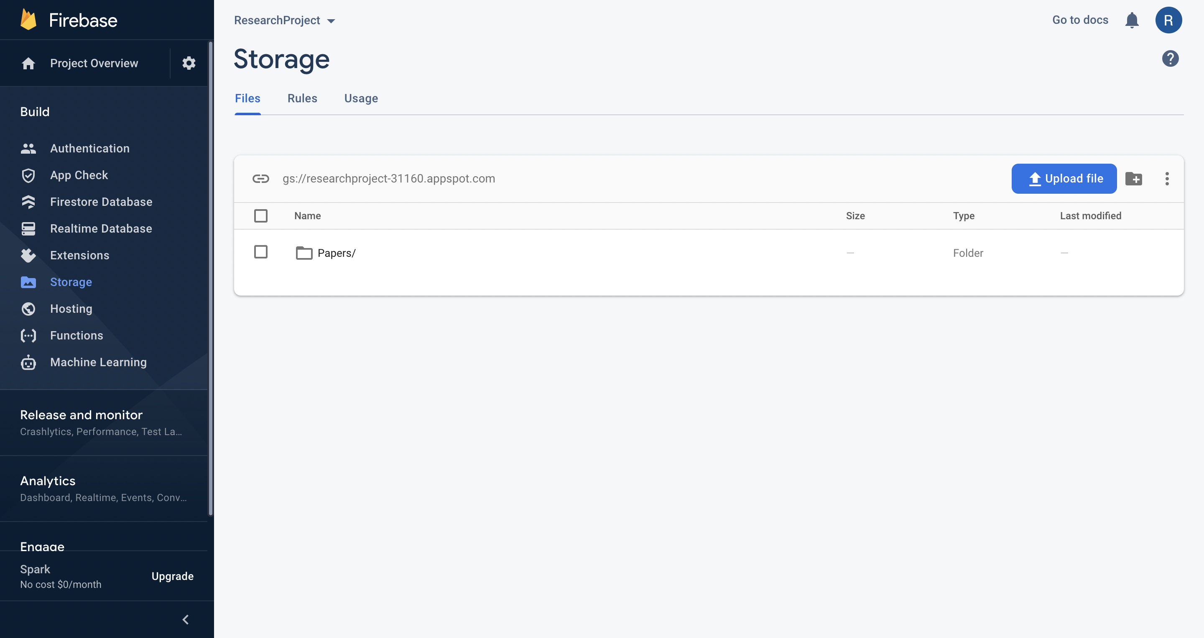

Slide 22
Challenges Faced:
The first problem we faced is everyone in our group is not experienced in React, We were all working together by learning and implementing while working.
We struggled initially for integrating firebase with React.
Main challenging issue faced was sorting functions.

Slide 23
Future work
We almost completed 80% of our project
We have completed uploading, searching and viewing the pdf
Finally, we have left with downloading the pdf and working on adding comment section under the pdf.

Slide 24

THANK YOU !

